Slide 1


CS214
github.com/mfmotawa/cs214Project
CS214 Project
CPU Scheduling Simulator

Slide 2
Students
ABDULMALIK ALHARBI
441110010
YASSER ALHARBI
442106544
MOHAMMED AL-MOTAWA
441109093

Slide 3
Introduction
CPU Scheduling Simulator
A console-based program that simulates CPU process scheduling
using basic data structures.
The project demonstrates how operating systems manage processes
based on priority.
GitHub Repository:
https://github.com/mfmotawa/cs214Project

Slide 4
Project Overview
  Simulates CPU process management
  Each process has ID, Burst Time, and Priority
  User can:
    Add, Edit, Delete processes
    Display all processes
    Run CPU scheduling simulation
  Data and results are stored in external files

Slide 5
Data Structures Used
Linked List
Queue
Priority Queue
Stores processes dynamically
Represents the ready queue
Selects the next process based on priority

Slide 6
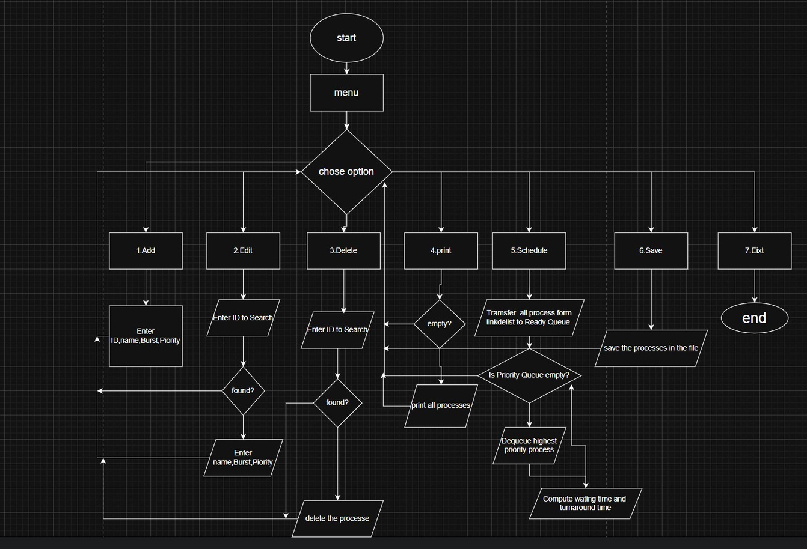
Flowchart

Slide 7
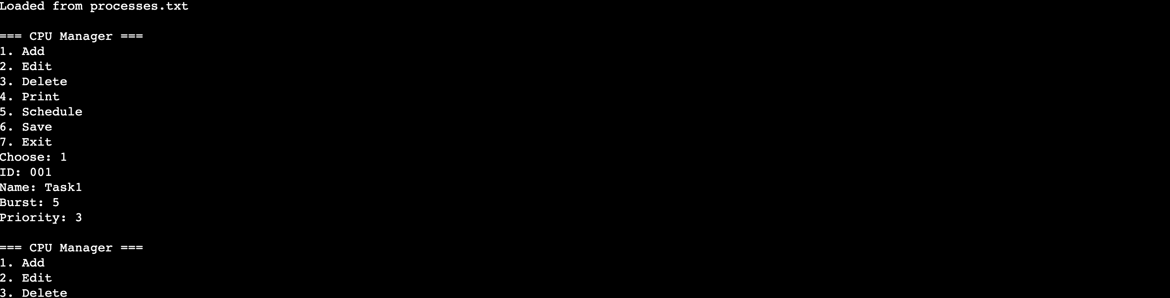
Program Screenshots
0. Main Menu

Slide 8
Program Screenshots
  add

Slide 9
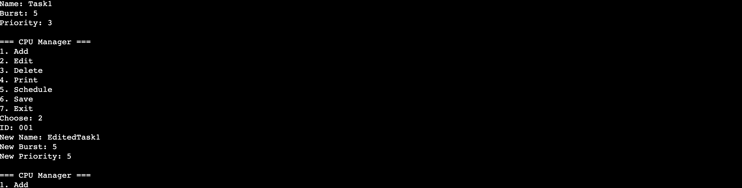
Program Screenshots
2. edit

Slide 10
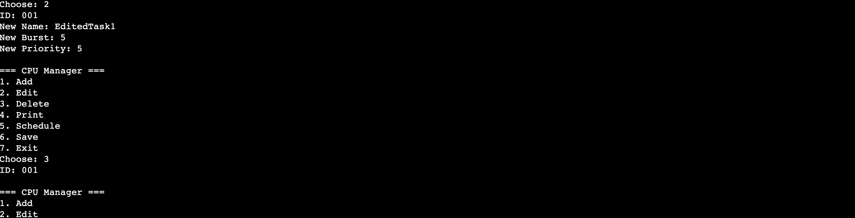
Program Screenshots
3. Delete

Slide 11
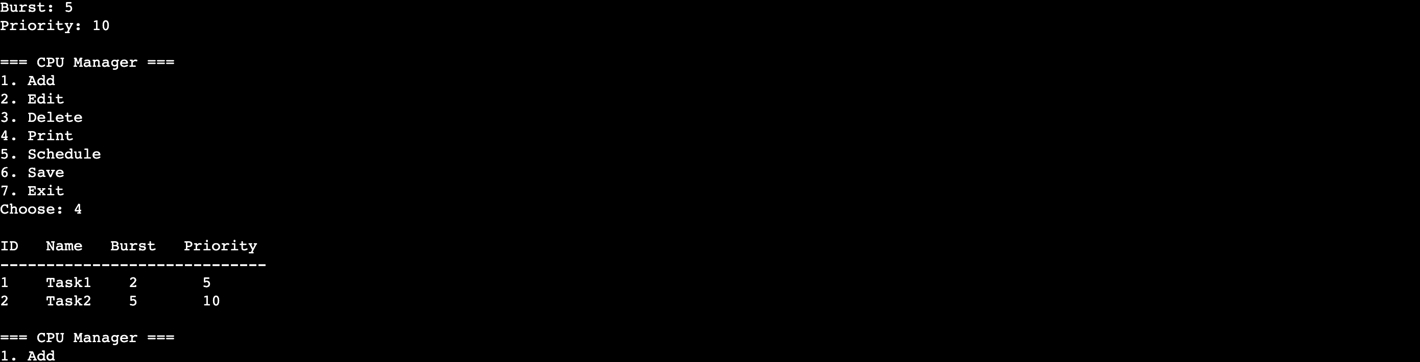
Program Screenshots
4. Print

Slide 12
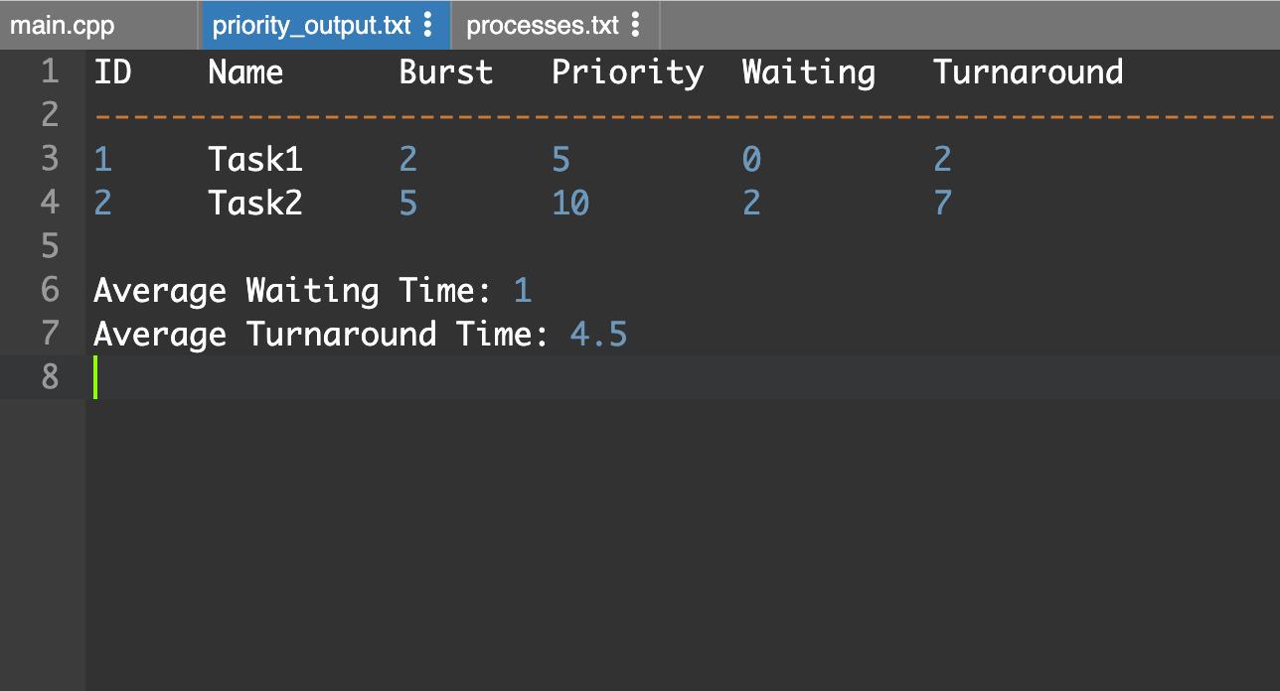
Program Screenshots
5. Schedule
in: priority_output.txt

Slide 13
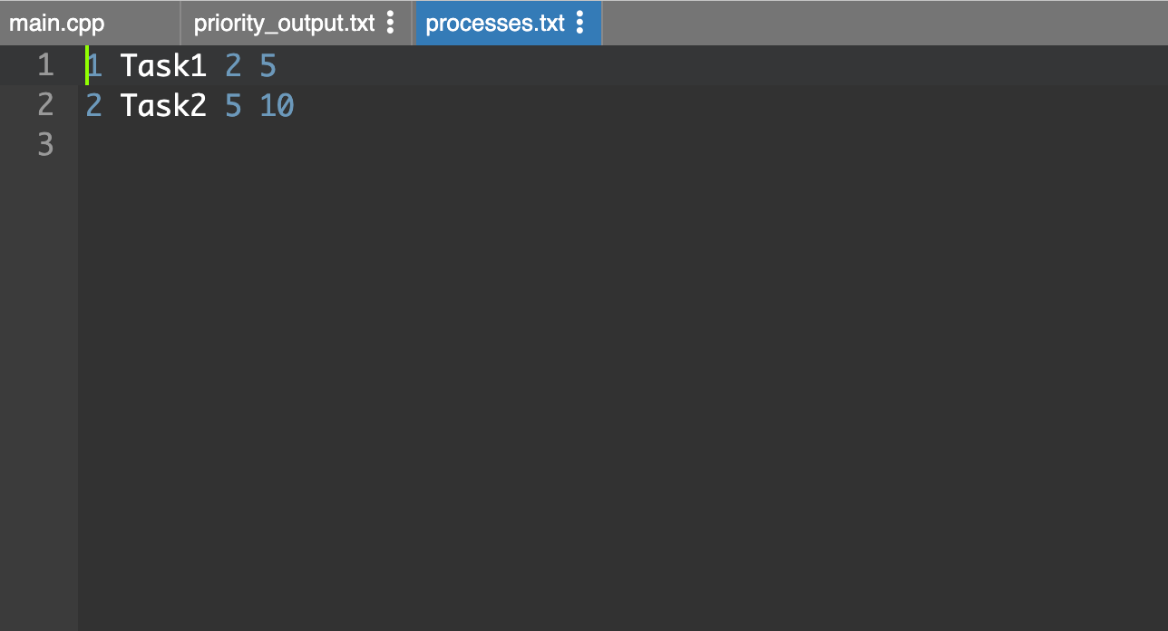
Program Screenshots
6. Save
in: processes.txt

Slide 14
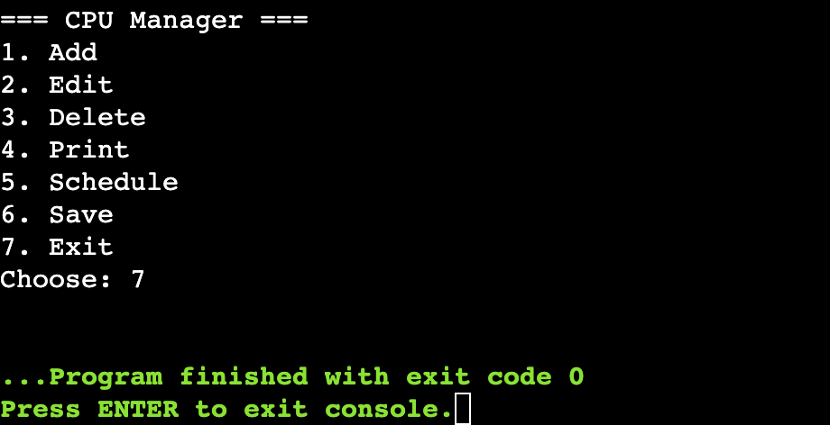
Program Screenshots
7. Exit

Slide 15
Thank You
Any Questions?

